Slide 1


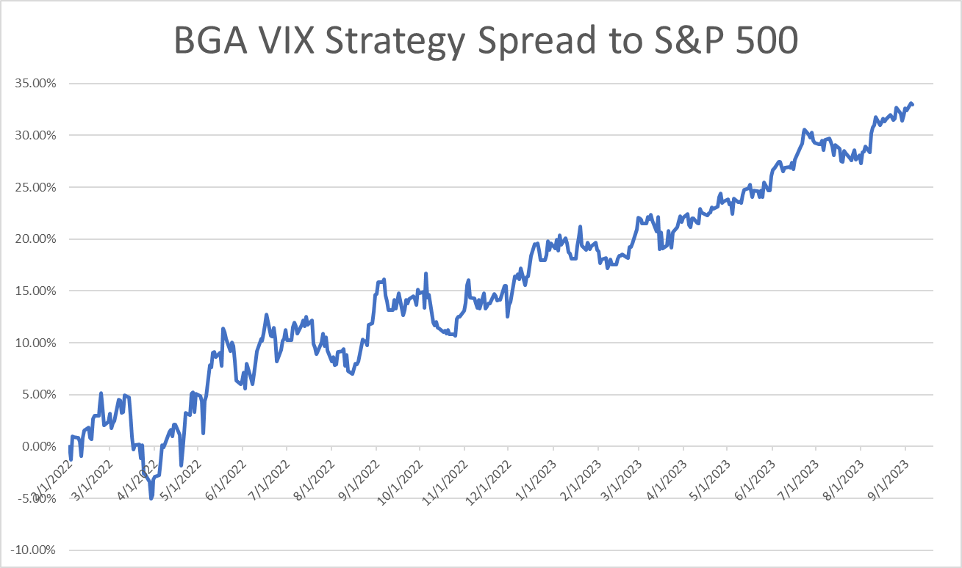
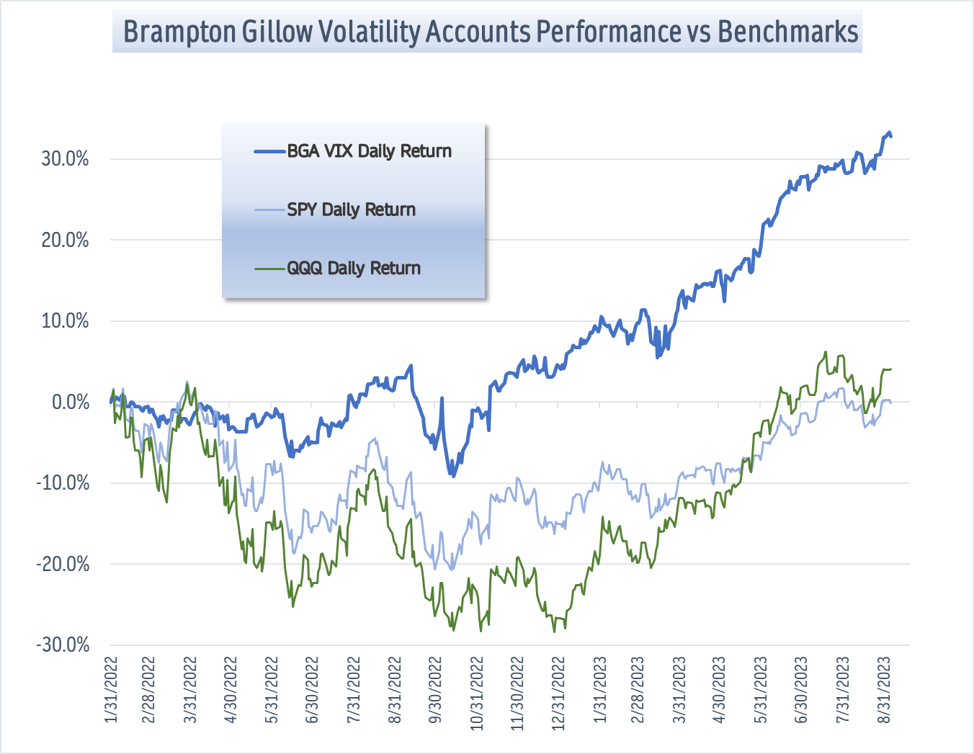

Investment Objective Inception 02/01/2022
Brampton Gillow Volatility and VIX product strategies strive to profit from the cost-of-carry function and relative predictability of mean-reversion tendencies inherent in market volatility characteristics. primarily using OTC options on VIX Futures and ETN securities. The strategy is conducted on an individual client basis, allowing us to precisely fit risk parameters to each portfolio.
VIX Product Strategies
YTD Return (Weekly) +28.1%
Annual Fee 1.5%
Holdings
As of 8/31/23
Holdings Detail: Strategy holds cash and generally purchases options. Target option equity –to- cash ratio is 20%-70%. During times of market stress and higher volatility, the ratio of option equity –to- cash may rise. For more detailed information see website or contact Christopher Bates directly.
For more info contact Christopher Bates Managing Director
cbates@bramptongillow.com Ph. (503)475-1054
Registered Investment Advisor

